Slide 1



Power BI Performance – 7 Deadly Sins!
Nikola Ilic
@DataMozart

Slide 2


Van drivers
CREDITS
Kevin Chant
Gethyn Ellis
Ásgeir Gunnarsson
Mark Hayes
Damir Matešić
Magnus Ahlkvist

Slide 3




Nikola Ilic
BI Developer @ITSP Services GmbH
Data-mozart.com
@DataMozart
I'm making music from the data!
Power BI and SQL Server addict, Data Platform MVP, MCT, blogger, speaker...
Father of 2, Barca & Leo Messi fan...

Slide 4




Creating Power BI report is an easy task!
@DataMozart

Slide 5

Where do I start?!
Data Model size
Data refresh process
DAX calculations
Visualization rendering time
Storage mode choice
@DataMozart

Slide 6

DATA MODEL SIZE

Slide 7


DATA MODEL SIZE
VertiPaq is a columnar database
Data snapshot in memory
Periodically refreshed
Formula Engine
Storage Engine
@DataMozart

Slide 8

DATA MODEL SIZE
@DataMozart

Slide 9

DATA MODEL SIZE BEST PRACTICES
Reduce the amount of data for import
Reduce the column cardinality
Avoid using calculated columns
Disable Auto Date/Time
@DataMozart

Slide 10

DATA MODEL SIZE SINS
DEMO
@DataMozart

Slide 11

DATA REFRESH PROCESS

Slide 12


DATA REFRESH PROCESS
Data transformations – currency conversion, filtering, calculations...
Where do you shape the data?
QUERY FOLDING = Ability to generate single SQL query to be executed on the data source side
@DataMozart

Slide 13
DATA REFRESH PROCESS SINS
DEMO
@DataMozart

Slide 14
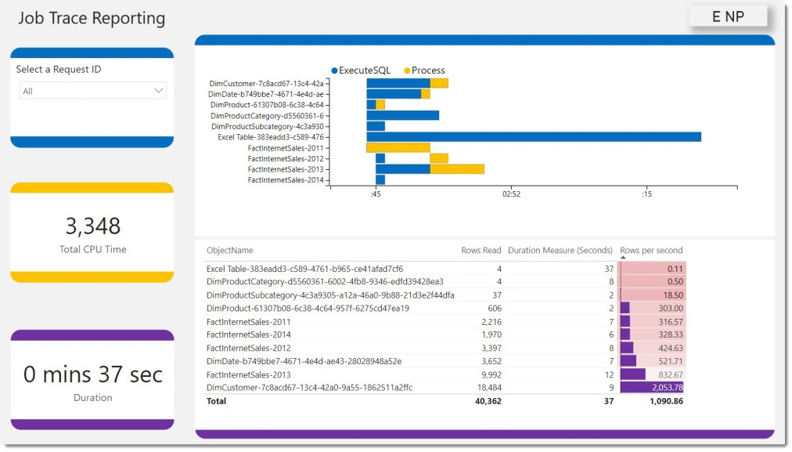
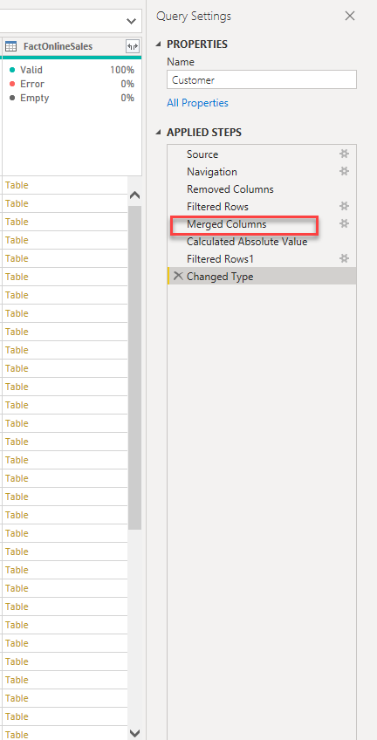
DATA REFRESH BEST PRACTICES
https://dax.tips/2021/02/15/visualise-your-power-bi-refresh/
Push transformations/calculations as close to a data source as possible
Create database views
ALL or NOTHING
Turn off Allow data preview to download in the background
@DataMozart

Slide 15

DATA REFRESH PROCESS GOLDEN RULE
„Push transformations and calculations as upstream as possible,
and as downstream as necessary!“
@DataMozart

Slide 16

DAX CALCULATIONS

Slide 17
DAX CALCULATIONS
Unique customers, top selling products, running totals...
The „beauty“ of DAX – get same result in multiple different ways
Little nuances can make a huge difference!
@DataMozart

Slide 18
DATA CALCULATIONS SINS
DEMO
@DataMozart

Slide 19

VISUALS RENDERING TIME

Slide 20

VISUALS RENDERING TIME
Performance Analyzer feature in PBI Desktop
The more visuals – the longer time for rendering!
@DataMozart

Slide 21
VISUAL RENDERING SINS
DEMO
@DataMozart

Slide 22
VISUALS RENDERING BEST PRACTICES
Reduce the number of visuals!
Use PowerPoint to design background of Power BI report page
Reduce the number of DAX query generated – Card visuals->Matrix
Display aggregated data by default, enable Drill-through for details
Consider disabling cross-filtering
Sync Slicers?
@DataMozart

Slide 23

STORAGE MODE DECISION

Slide 24
WHAT IS A DIRECT QUERY?!
Data is retrieved from the source at the query time!
Data resides outside of Power BI before, during, and after the query execution
Direct Query will NEVER improve performance of your Power BI report!!!
@DataMozart

Slide 25
WHEN TO USE A DIRECT QUERY?!
Data is too large for Import mode
Real-time reporting requirements
Is it really necessary?
Security policies on the data source side
@DataMozart

Slide 26


DIRECT QUERY BEST PRACTICES
Permissions on the data source?
Create proper indexes
Data integrity
Persistent data objects
Avoid complex PQ transformations
Avoid complex DAX measures
Avoid relationship on GUIDs
Limit parallelism and apply Query reduction
Check Assume referential integrity
@DataMozart

Slide 27
DIRECT QUERY BEST PRACTICE!
AVOID DIRECT QUERY IF POSSIBLE!
@DataMozart

Slide 28

SUMMARY
Identify the poor performing area(s)
Remove unnecessary data
Check Query folding
Be mindful when writing DAX
Reduce the number of visuals on the page
Stay away from Direct Query!

Slide 29

QUESTIONS

Slide 30



THANK YOU!
Data-mozart.com
@DataMozart

